Slide 1
The Hive CSE406: Computer security sessional
1905102: Md. Shafiul Haque
1905116: Md. Sayeeduzzaman

Slide 2
Introduction
The Platform for Security Incident Response
Integration to automate the analytic process with other tools (MISP, Cortex, etc.)
Improved collaboration and coordination among security stakeholders, fostering a cohesive approach to incident resolution.
Integration with other tools (MISP, CORTEX etc) to automate the process of analysis

Slide 3
Key Features
Collaborative multitenancy
Advanced User management
Case management
Alert management
Metrics and dashboards
MISP Integration
MITRE ATT&CK knowledge base Integration
Deployment everywhere

Slide 4
Benefits
Reduce the time needed to process cases
Speed up the handling of alerts
Make more accurate analysis
Cut down integration costs by 40
Get your analysts up and running in record time

Slide 5
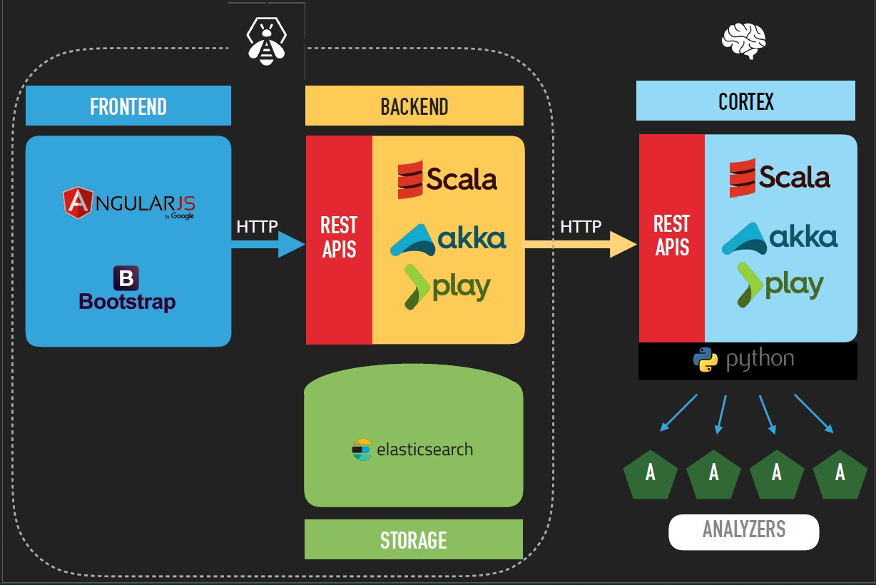
Architecture

Slide 6
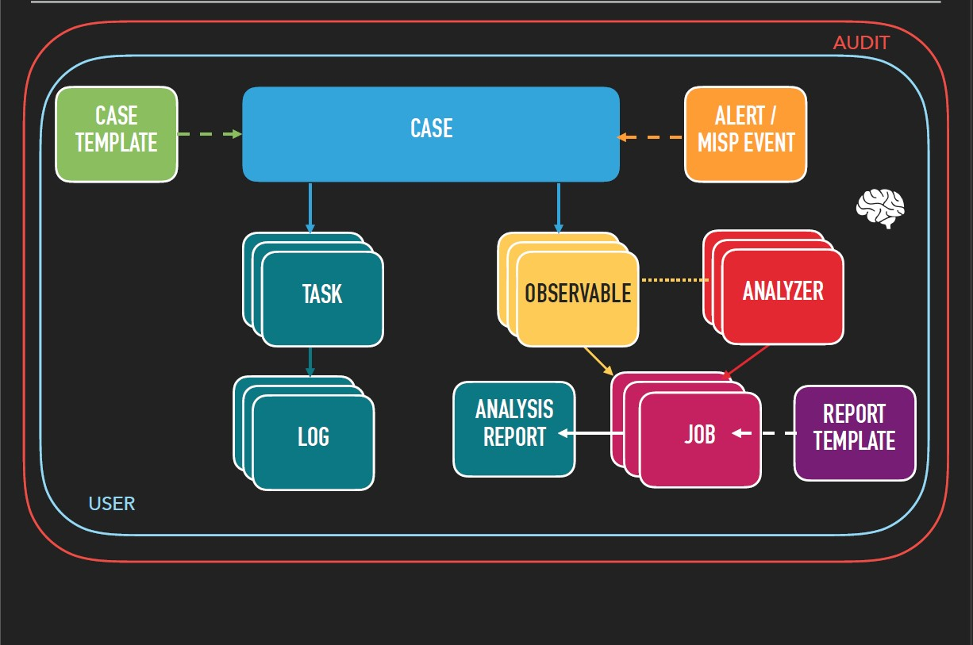
Workflow

Slide 7
Demo Feature Part 1
User Management and Case Creation

Slide 8
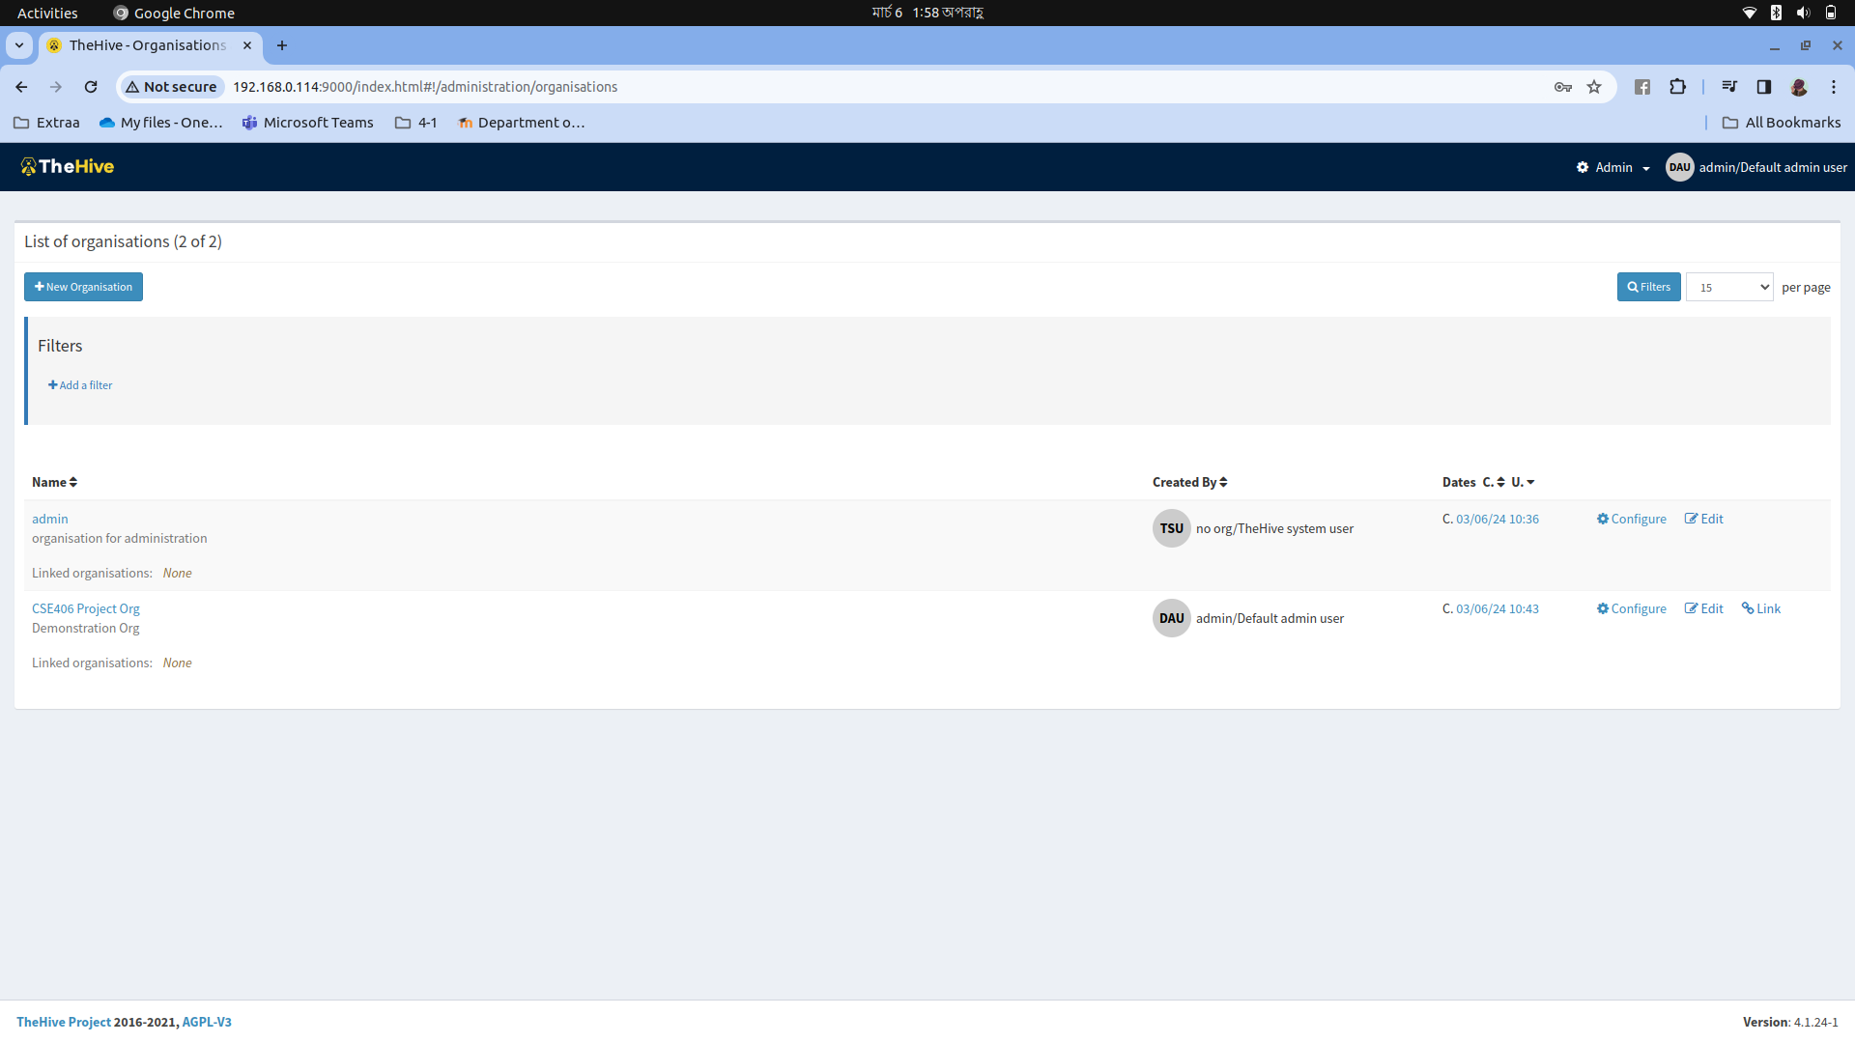
Step1: Admin Landing page

Slide 9
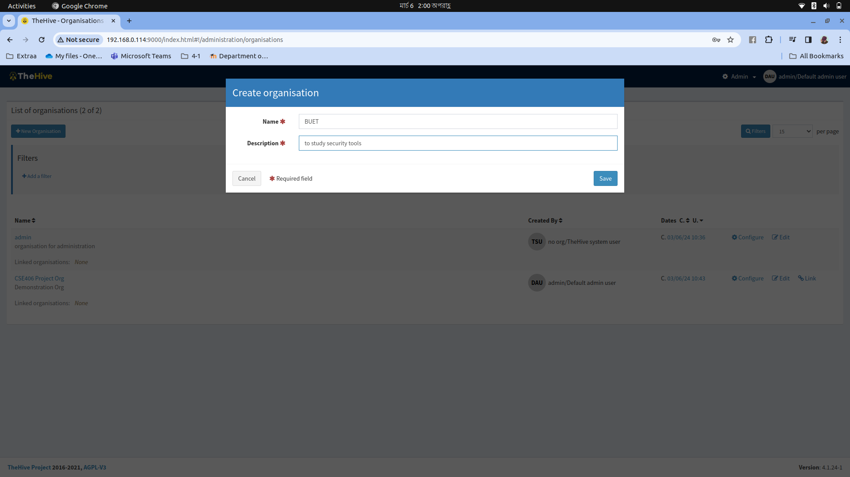
Step2: Creating organizer

Slide 10
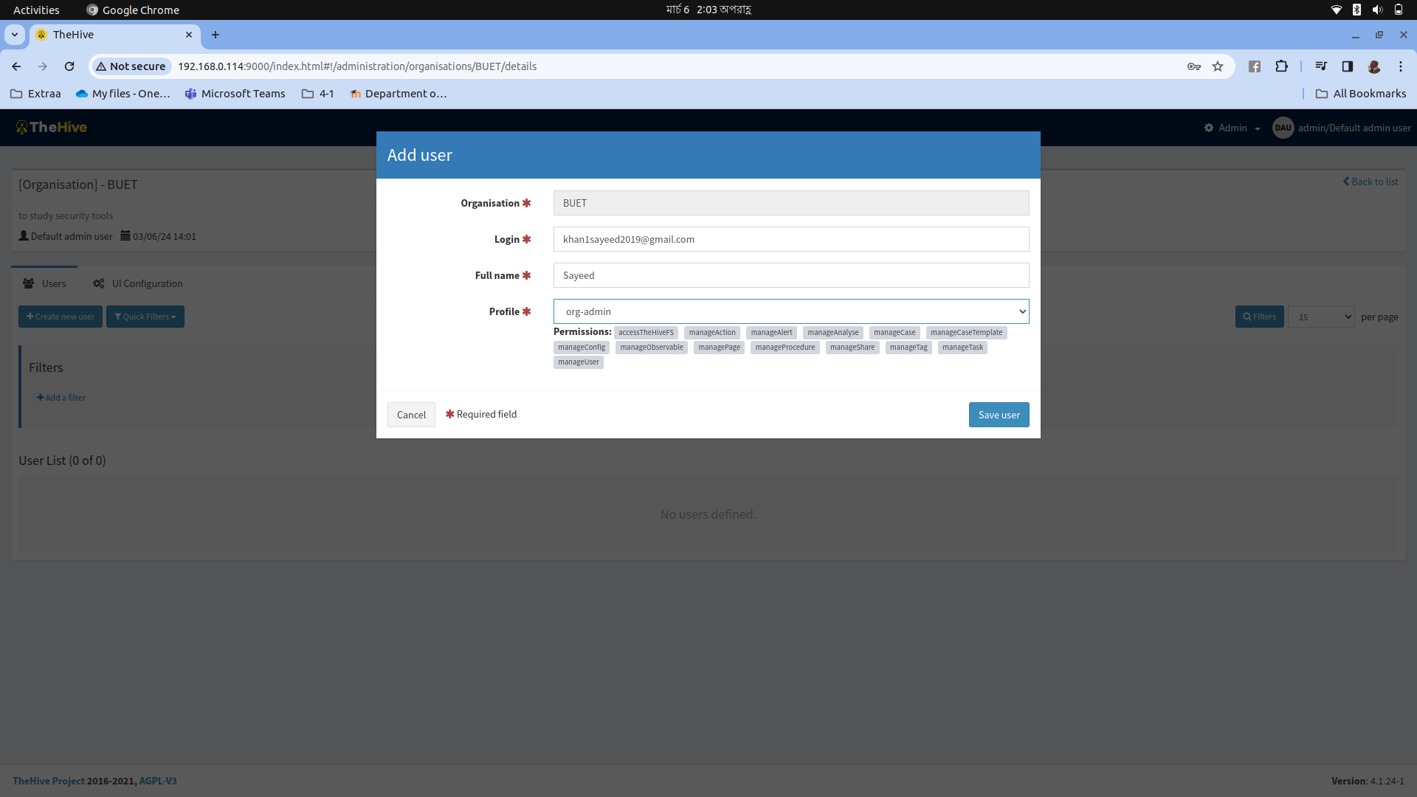
Step 3: Creating Users

Slide 11
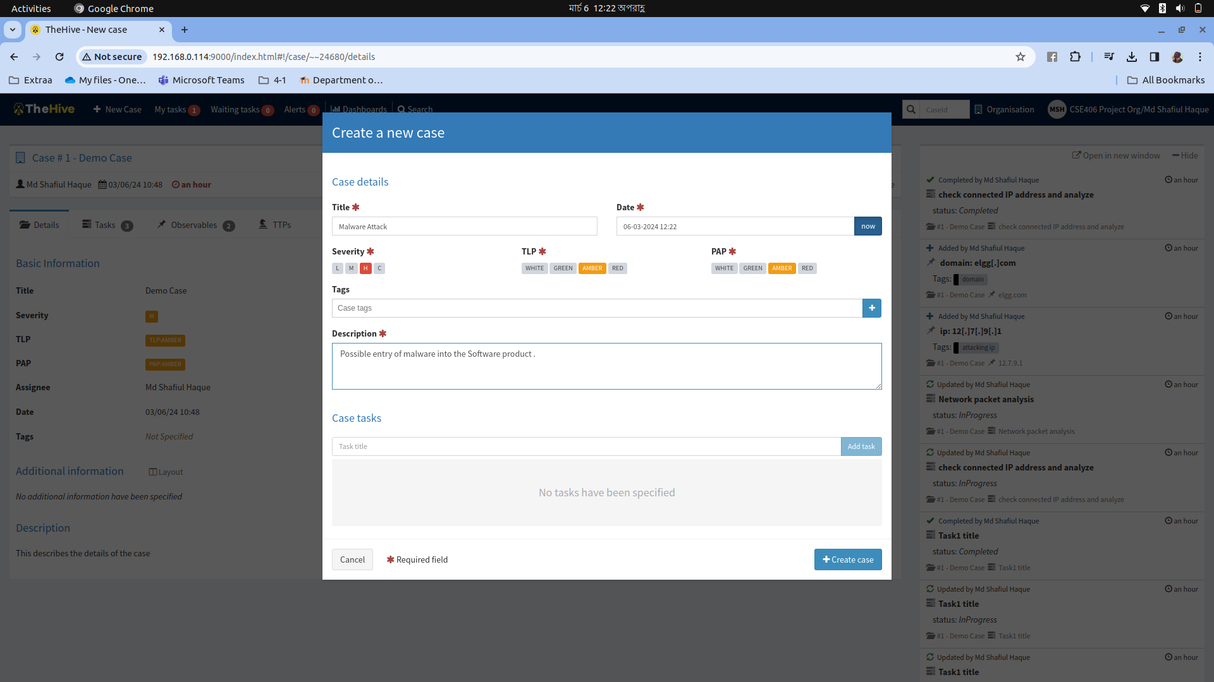
Creating New Case

Slide 12
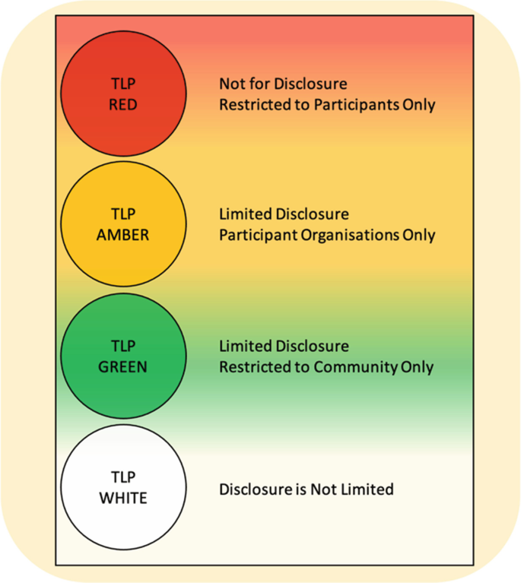
TLP

Slide 13
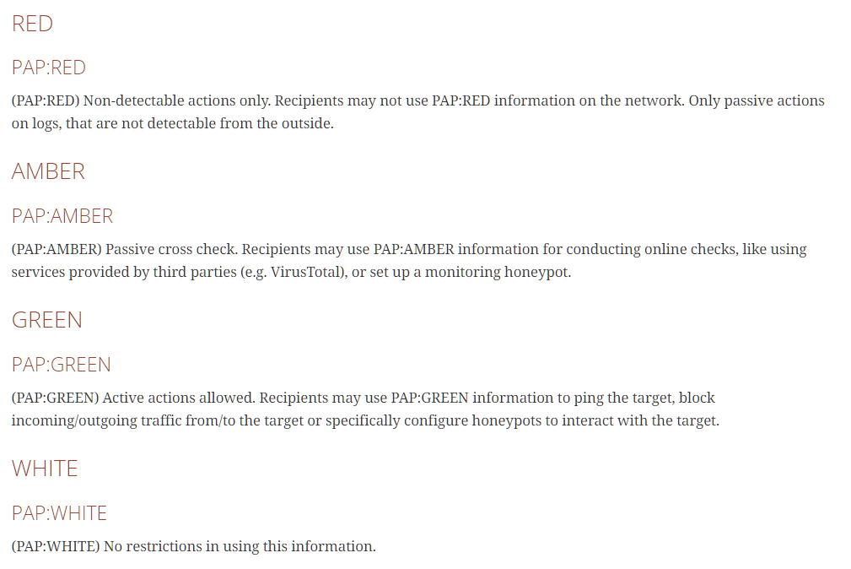
PAP

Slide 14
Demo Feature Part 2
Task and Alert Management

Slide 15
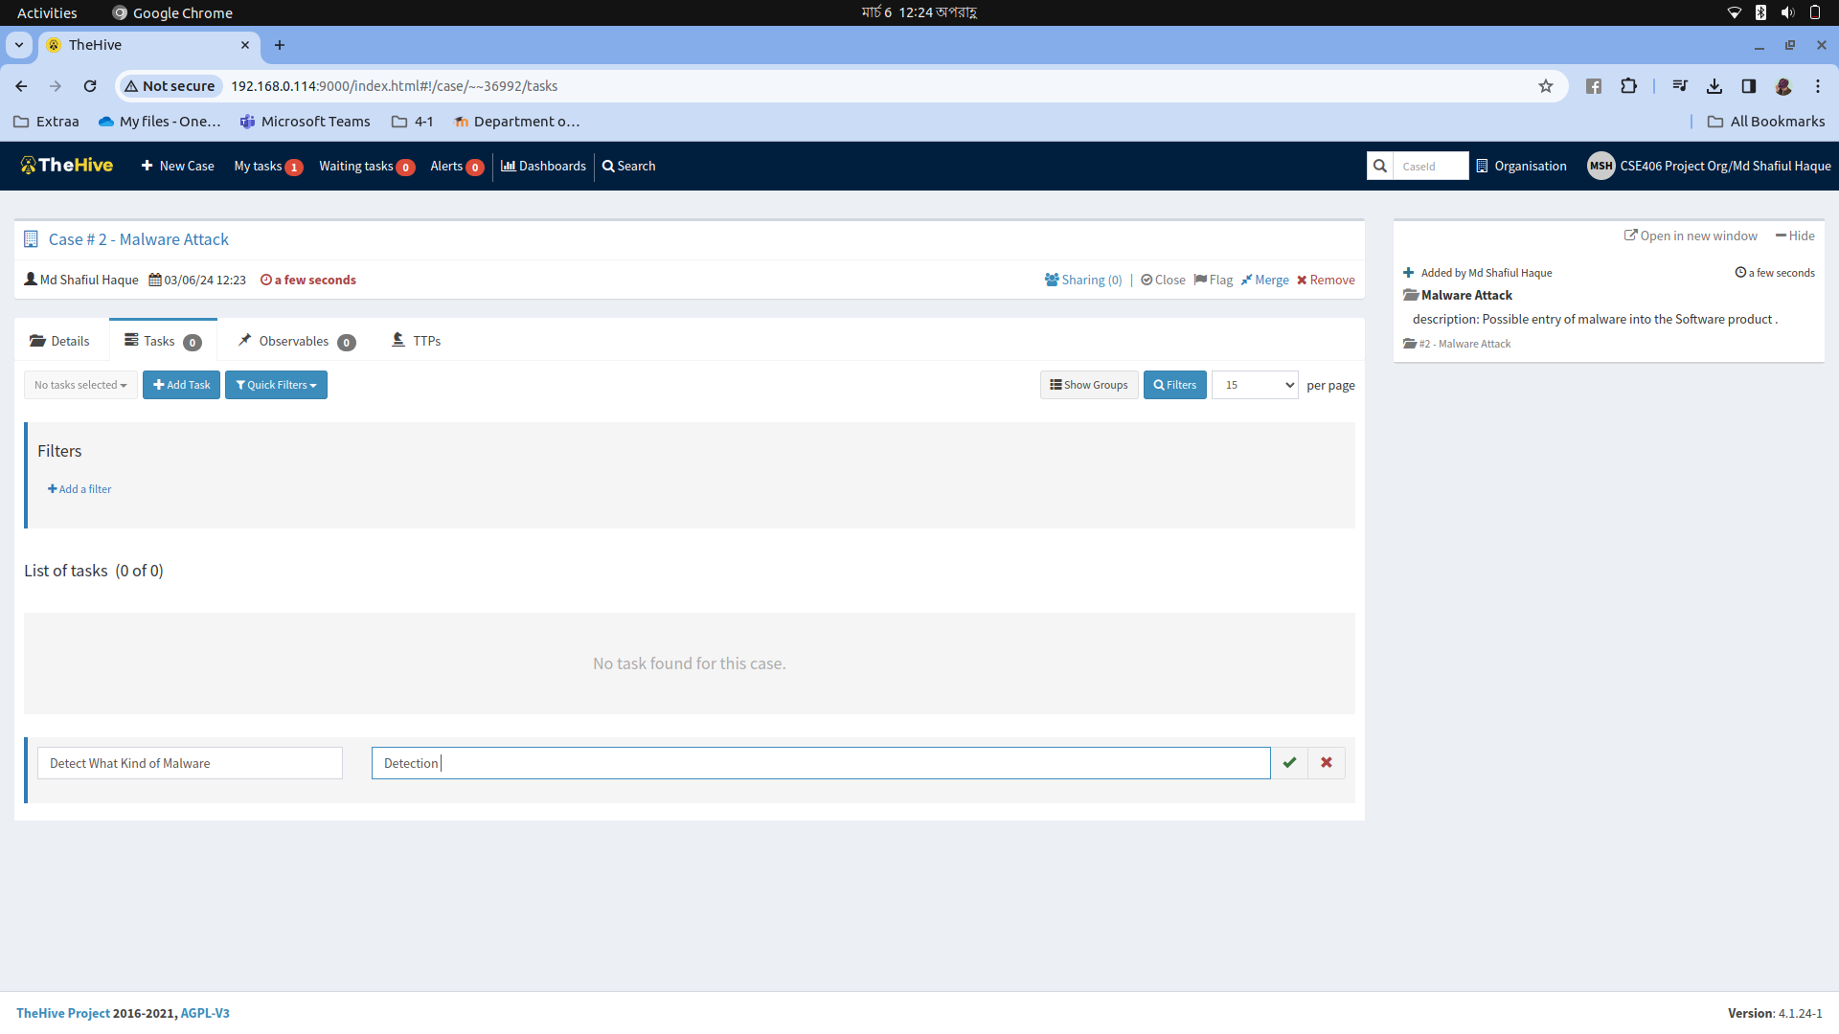
Task creation

Slide 16
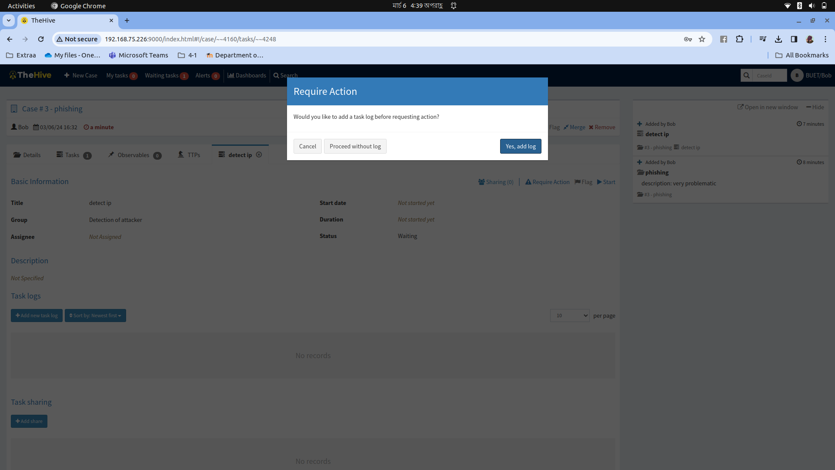
Alert Management beginning

Slide 17
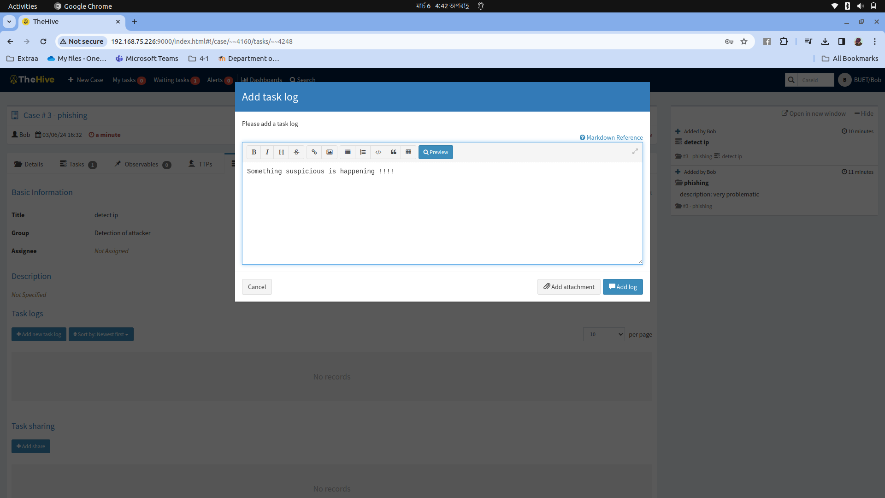
Adding task log to alert

Slide 18
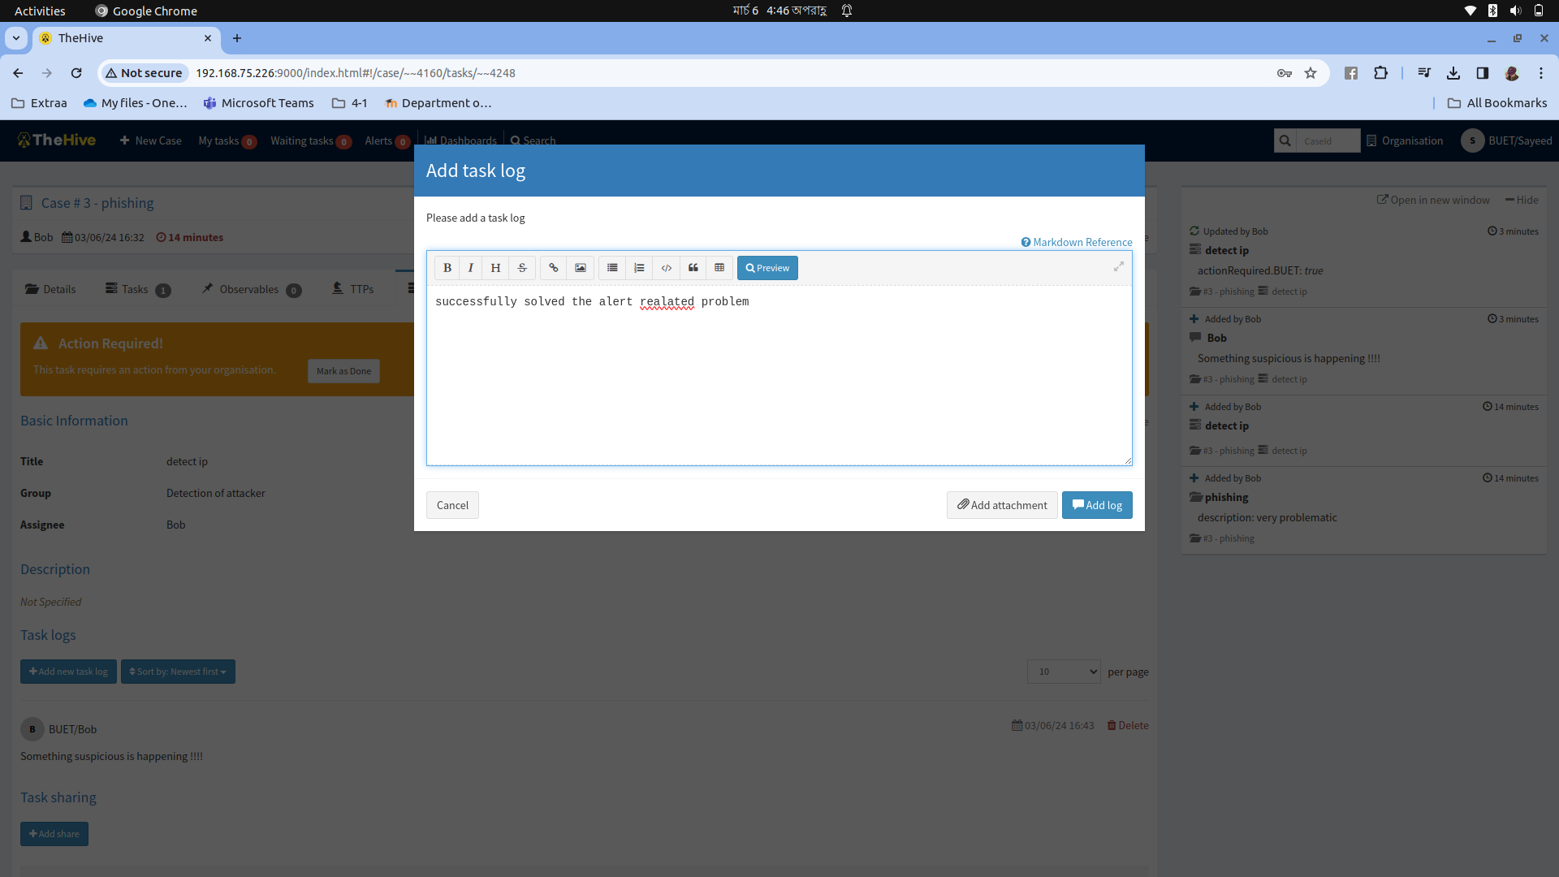
Solving the alert

Slide 19
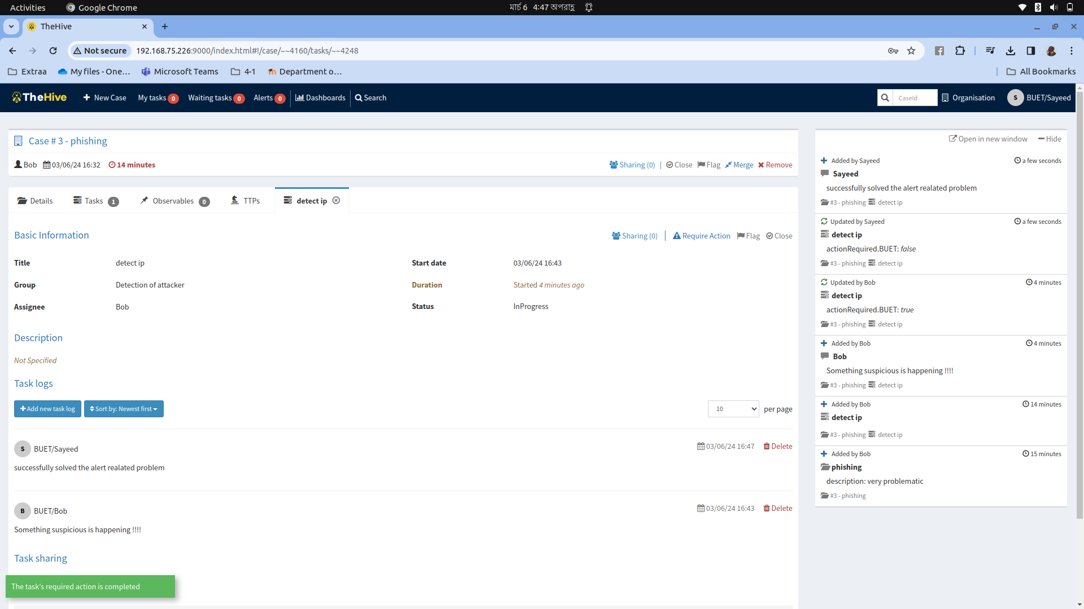
Problem solved

